Slide 1
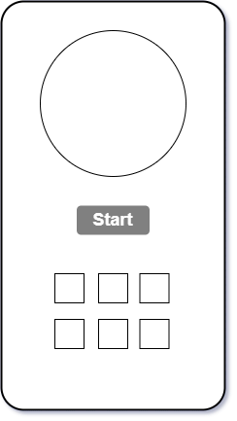
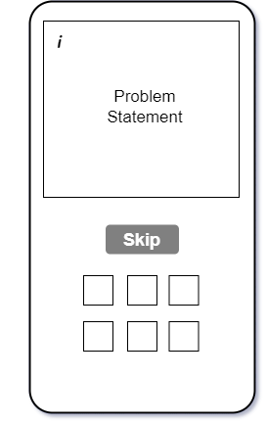
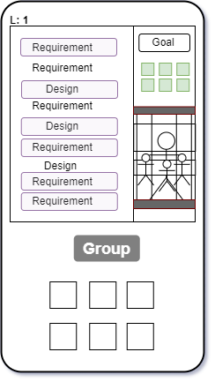
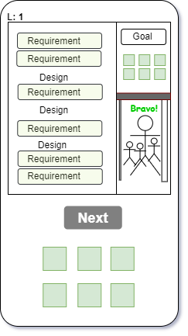
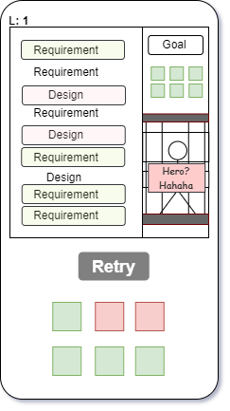





User Journey Map
Stages | Generate Problem Statement | Read Problem Statement | Highlight requirements | Results
Actions & Touchpoints
Thoughts & Emotions | Confuse about how to start | Worry that skipping might lead to missing out | Exciting but unsure, second-guessing | Joy or frustration based on whether grouping success or fails
Opportunities | Add animation, hint on button Start | Hint on what to do, Allow an Undo Skip option within a limited time | Incorrect highlights, allow deselection | Add feedback such as “Why not hero?” , Improve Incorrect highlights to make mistakes clearer
Anticipated emotions:

Slide 2


Underground Hero’s Journey
Introduction | Incident | Rising Action | Climax | Falling Action | Resolution
Game context: Quality requirements & Design Chaos in underground | Intro in the game: How to play Why to play Start button activated Learn how to fix the system | Game start: Problem shown Requirements pool ready | Grouping box: Generate problem statement Read problem statement Highlight requirements Make final guess | Last requirement to resolve the game: Hero or not Hero Retry option | Game Summary: Player results Next Level
Ordinary world | Call to adventure | Crossing the treshhold | Tests, alies and enemies | The reward | Return with the elixir
Underground system out of order (not functioning properly) | Hero is invited to fix broken logic | Hero accepted his challenge and steps into the unknown | Encounters tricky requirements & distractors, Fixing broken logic one by one | The System is fully fixed | Hero growth, new abilities unlocked
Passive | Passive ? Add action | Passive | Active | Passive ? Add action | Passive

Slide 3
Tittle
Literal Action or Punny Purple cow Dramatic Referential Cool
Underground Fix
Underground
Hero
Underground Subway-Fix
Underground Legenda!
Legacy of Underground
The Last Underground Operator
The Official tittle : Underground Hero
Team : Ntoh Batex Bafika, Bekassyl Adenov, Gianna Quenum,Nicolas Cholin, Tagne Chiby Ellios, Sujai Shanmugam, Rofig Ashumov, Abbas Rzayev, Rufi Aliyev, Davyd Bogomolov, Gasim Jabrayilov

